Slide 1
FlashAttention:
Fast and Memory-Efficient Exact Attention with IO-Awareness
EECS 598: Sys4GenAI
Zhenning Yang, Jiaheng Lu, Jeremy Flics
03-19-2024
Notes:
shift+command+F to full screen in presenter mode
https://papers.nips.cc/paper_files/paper/2022/file/67d57c32e20fd0a7a302cb81d36e40d5-Paper-Conference.pdf

Slide 2
Agenda
Motivation
Background
FlashAttention
Evaluation
Summary

Slide 3
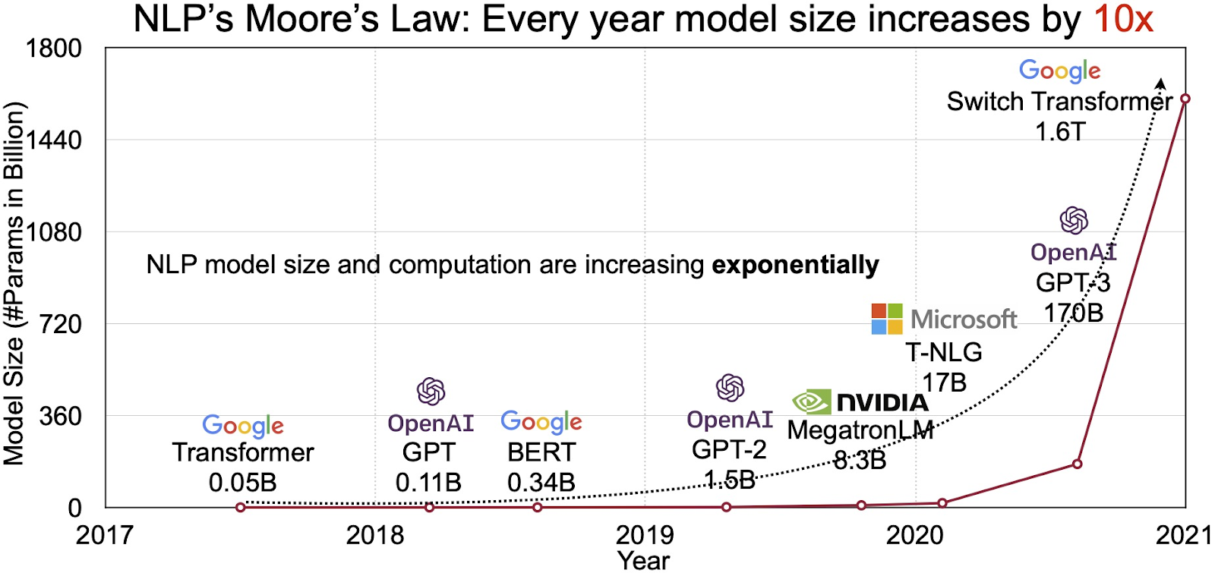
Motivation
Notes:
There has been a lot of advances in deep learning. With these new hardware, namely more powerful GPUs, ML researchers are now able to train large DNNs. …
People found that larger DNNs tends have a better capability in terms of learning,
And when you trained them with large among of data, it often outperformed smaller models, and have better performance.

Slide 4
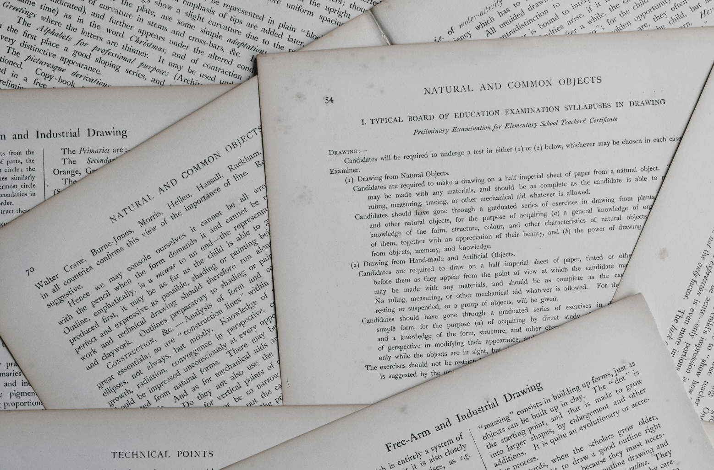

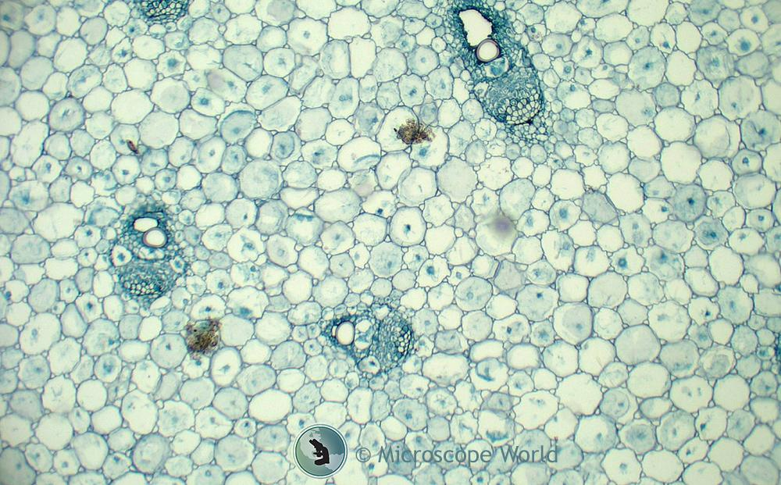

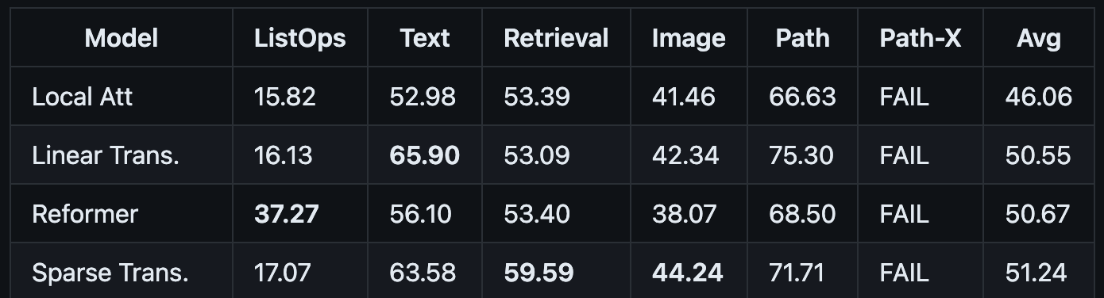
Motivation: Transformers do not scale very well
Attention scales quadratically to sequence length
Long-Range Arena
A suite of tasks consisting of sequences ranging from 1K to 16K tokens
Notes:
Problem with scaling, Attention is key comp
Scale quadratically to sequence length
Limit use case in applications,
Many works have shown that modeling context with longer sequence usually provide better insights….

Slide 5
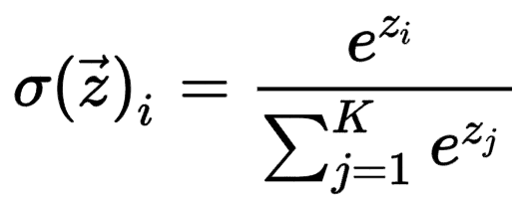
Background: Attention
Q
(N x d)
K
(N x d)
S = Q K^{T}
(N x N)
P = Softmax(S)
(N x N)
V
(N x d)
O
(N x d)
Pairwise Similarity
Score
O = Softmax(Q K^{T} )V
Notes:
=> row-wise normalization (sfm) => appear to be prob, sum to 1.
Notation in the paper

Slide 6

Background: Approximate Attention
Combinations
Reformer (Kitaev el al. ICML 2020)
Routing Transformer (Roy et al. ACL 2021)
Sparse
Lowrank
Performers (Choromanski et al. ICLR 2020)
Fast-transformers (Katharopoulos, et al. ICML 2020)
Linformer (Wang et al. 2020)
A
B^{T}
Reduce FLOPs should make it faster!
Longformer (Beltagy, et al. 2020)
Scatterbrain (Chen et al. NeurIPS 2021)
Big Bird (Zaheer et al. NeurIPS 2020)
Sacrifice model quality.
ML folks

Slide 7

GPU Performance Characteristics
Compute-bound
Spending most of its time doing compute
Example operations: convolution, matrix multiply
Memory-bound
Spending most of its time moving data
Example operations: Softmax, layer norm
I have another idea to reduce FLOPs!
Sure, not going to work…
System folks
ML folks

Slide 8
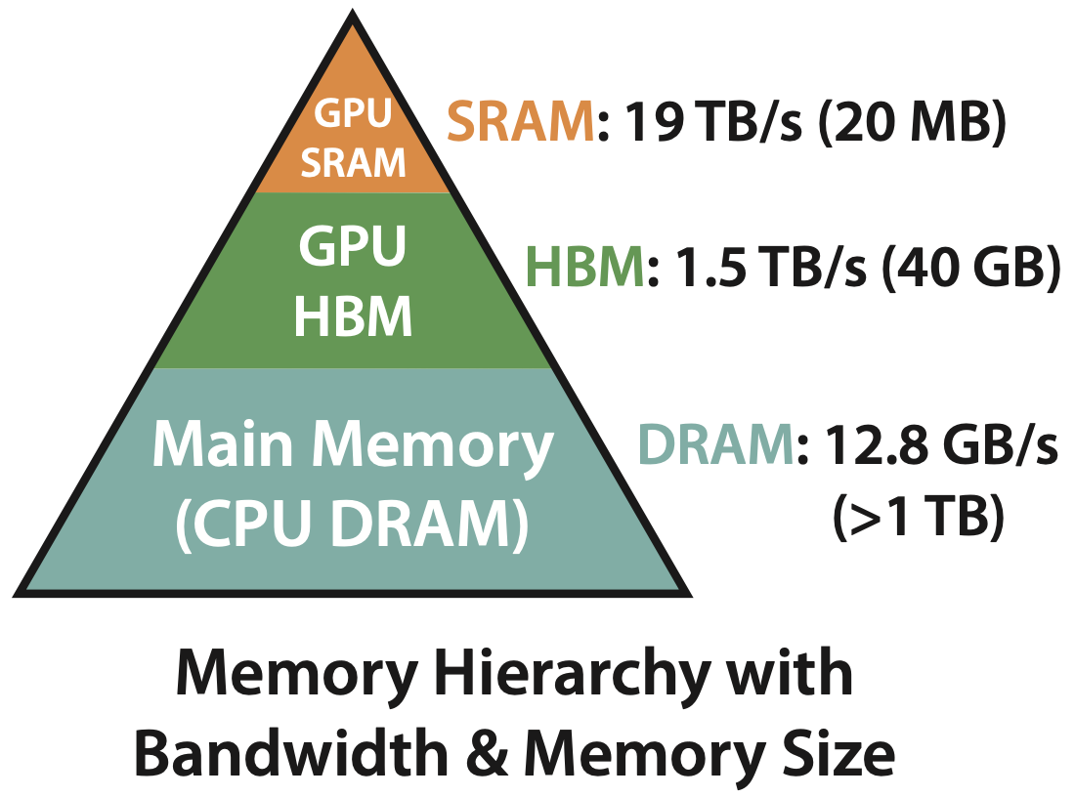
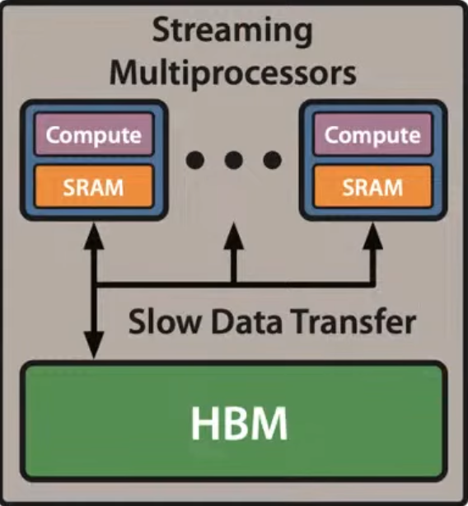
GPU Performance
…

Slide 9
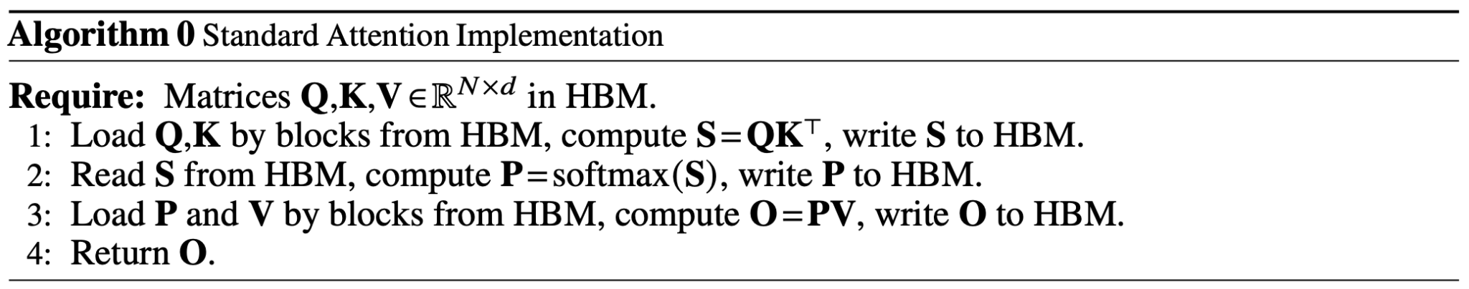
Standard Attention
Q
(N x d)
K
(N x d)
S = Q K^{T}
(N x N)
P = Softmax(S)
(N x N)
V
(N x d)
O
(N x d)
Notes:
Materialize

Slide 10
Standard Attention
Q
(N x d)
K
(N x d)
S = Q K^{T}
(N x N)
P = Softmax(S)
(N x N)
V
(N x d)
O
(N x d)
Row-wise sum needed
You better not change the math. That’s my job…
ML folks
System folks
Notes:
Identify bn

Slide 11

IO-Aware Attention: FlashAttention
Can we compute softmax by block?
Tiling
Can we NOT store NxN matrix in backward pass?
Recomputation
MLSys folks
Exact attention? YES!
Notes:
…
The meat is tiling…

Slide 12
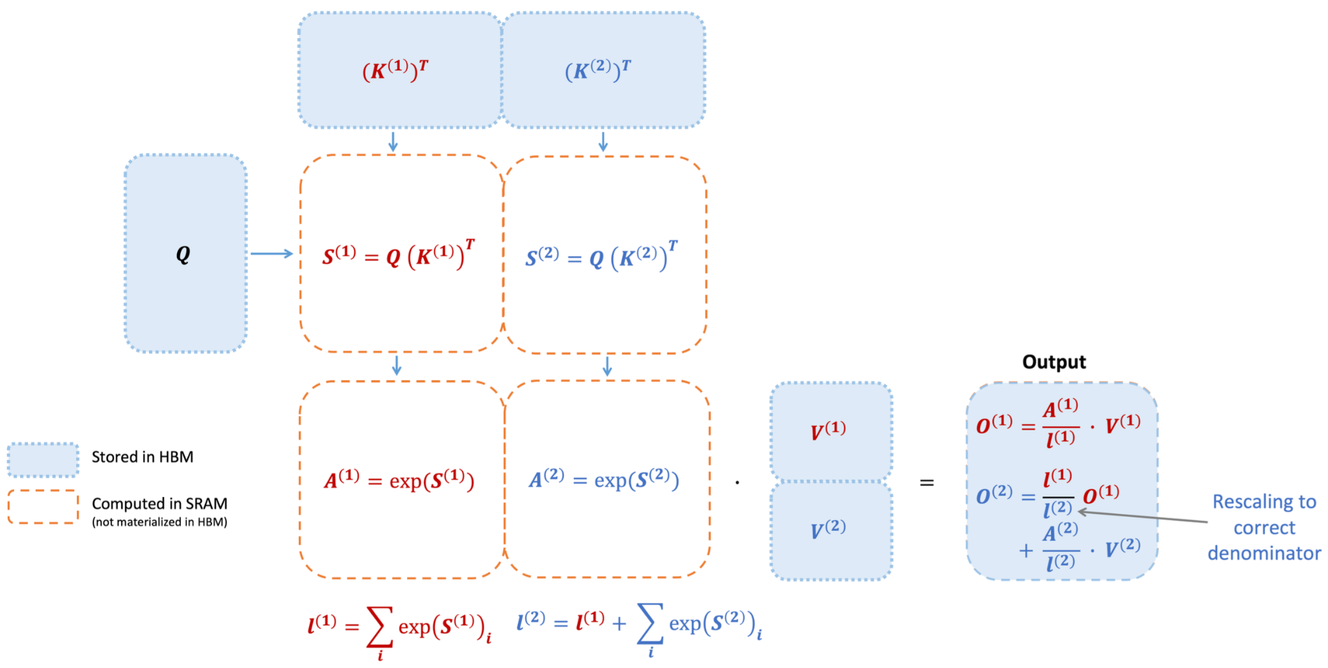
FlashAttention: Tiling with Softmax Re-scaling
O = Softmax(Q K^{T} )V
Notes:
Attention computation, but written in a different way.

Slide 13
FlashAttention: Tiling with Softmax Re-scaling
O = Softmax(Q K^{T} )V
Wrong denominator
Notes:
It seem like, we could compute Att by block. …
But what is NOT so good is that…

Slide 14
FlashAttention: Tiling with Softmax Re-scaling
O = Softmax(Q K^{T} )V
Wrong denominator

Slide 15
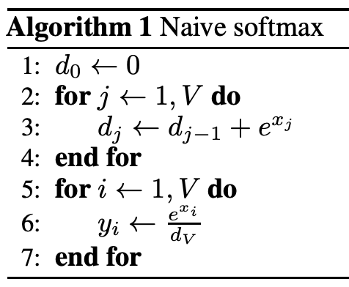
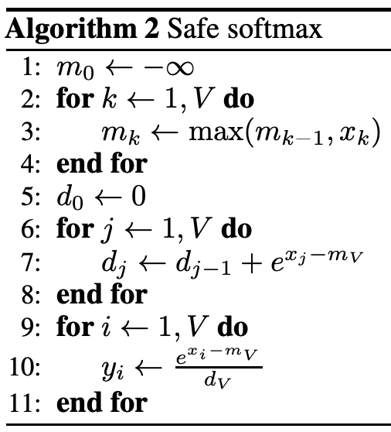
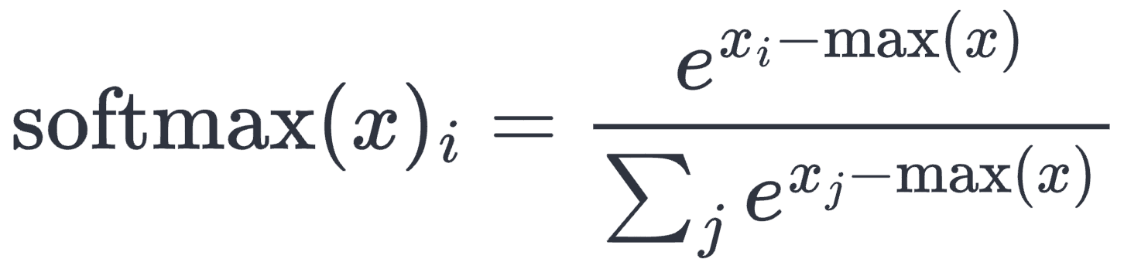
FlashAttention: Numerically Stable Softmax
Potentially overflow
TensorFlow v1.7
PyTorch v0.4.0
MXNET v1.1.0
Milakov, et al. Online normalizer calculation for softmax, arXiv, 2018
Notes:
Compute things by Block, you only have local max.

Slide 16
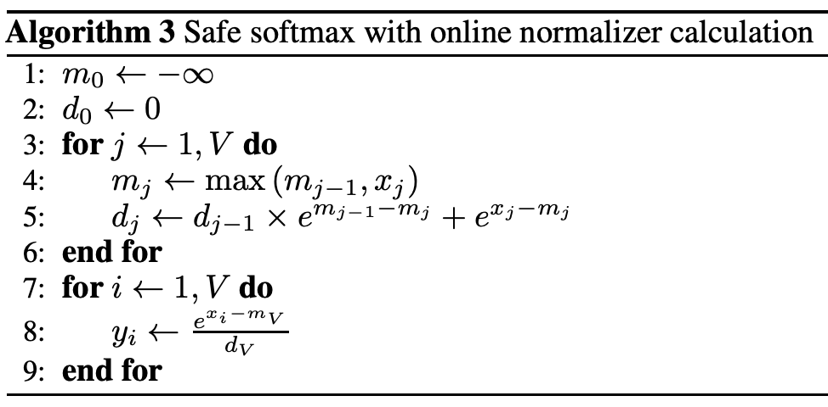
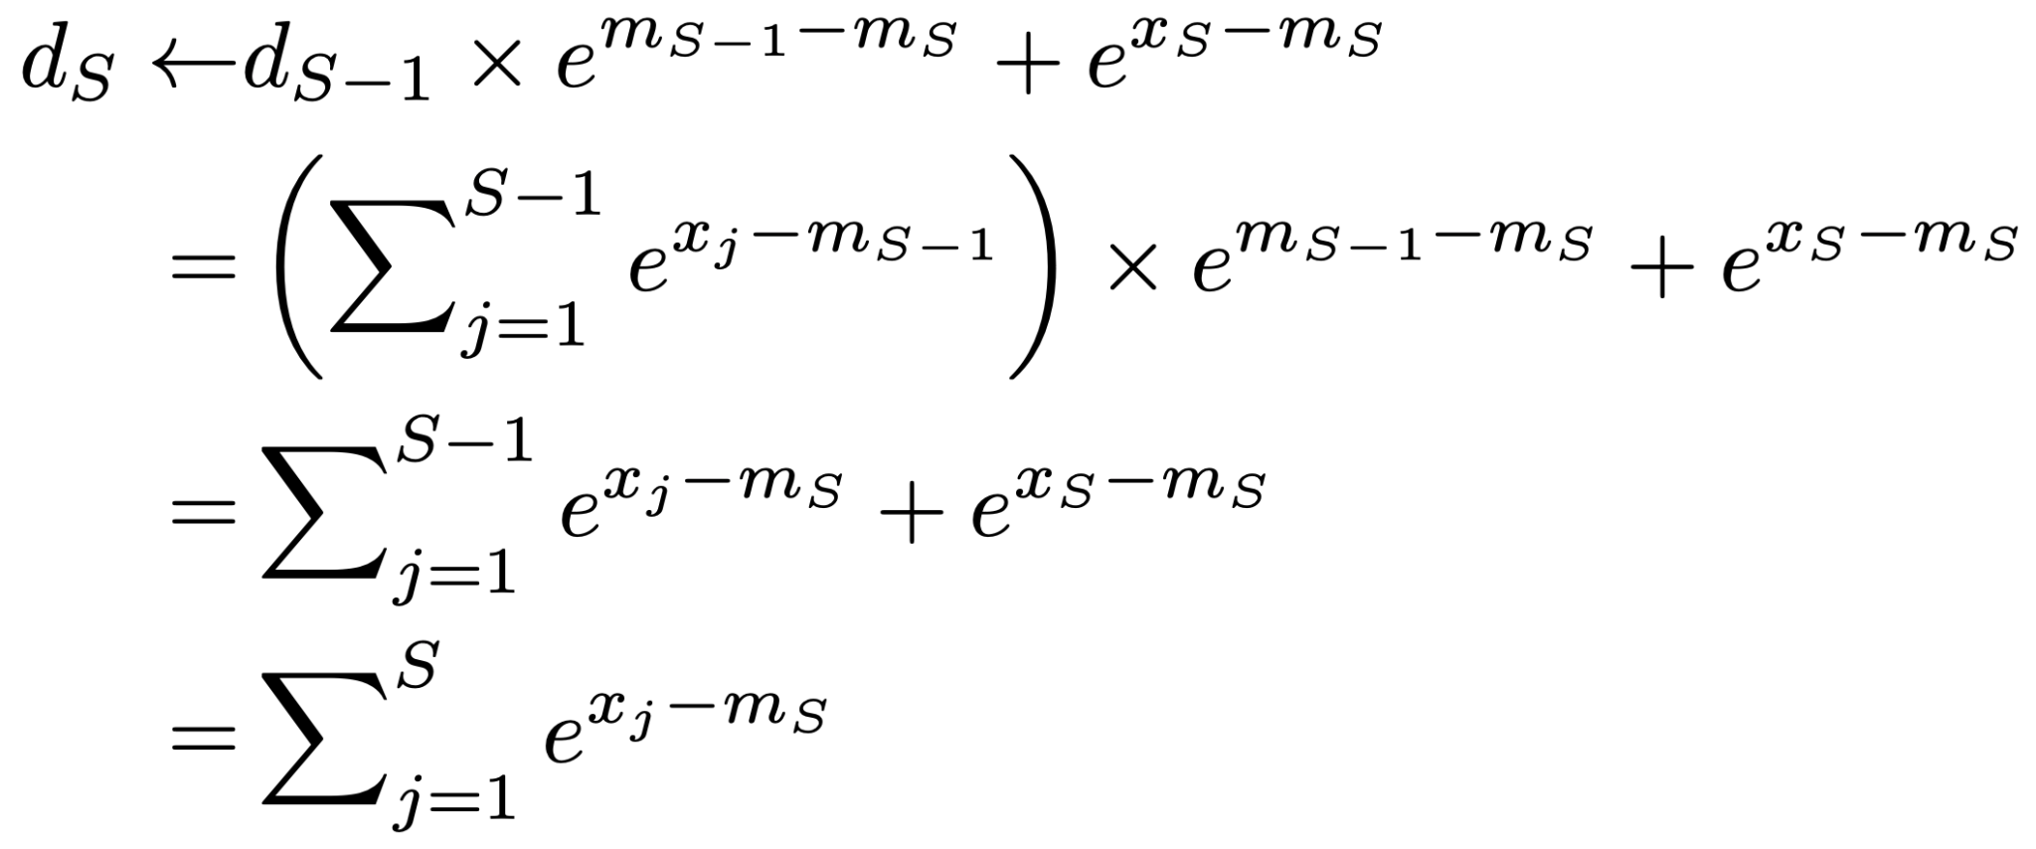
FlashAttention: Numerically Stable Softmax
Outdated local max
New local max
Running maximum
Online error correction
Milakov, et al. Online normalizer calculation for softmax, arXiv, 2018
Notes:
Trick
Keep track of local max, correct error on the fly

Slide 17
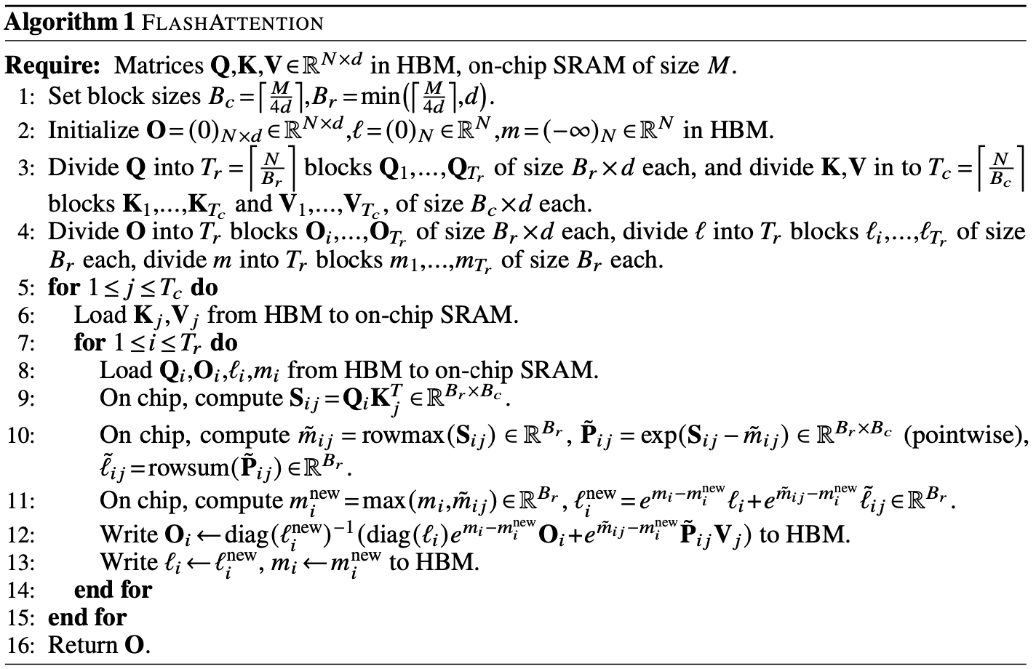
FlashAttention: Numerically Stable Softmax
Error correction
Re-scaling
Keep track of some statistics
Notes:
Error correction
Online normalizer calculation for softmax

Slide 18
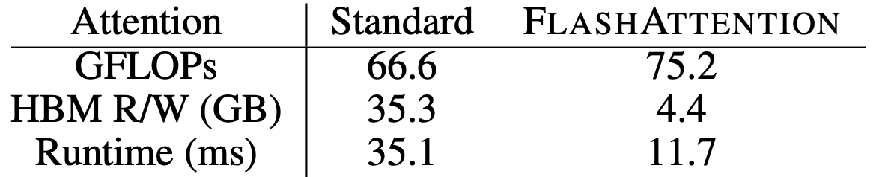
FlashAttention: Recomputation
Store softmax normalization factor from the forward pass (N) and recompute attention in the backward pass.
Notes:
GPT-2 med, on A100

Slide 19
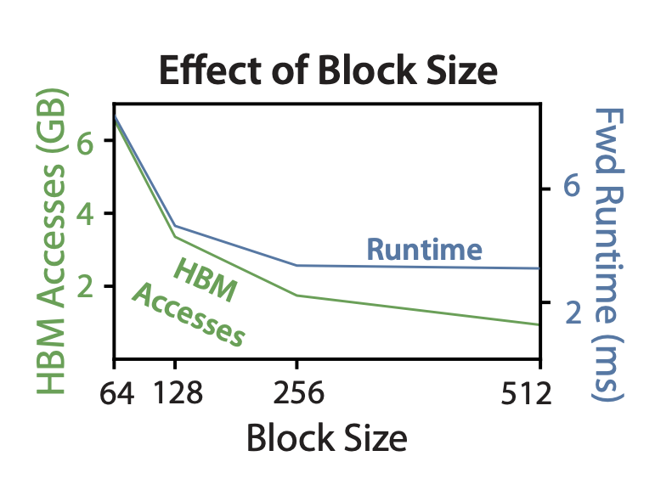
Effect of Block size
Fewer HBM accesses result in faster runtime, up to a point
Notes:
Increment of block size leads to reduce for HBA accesses
Won’t always increase, result in faster run time up to a point

Slide 20
Evaluation
Training Speed.
Outperforms the MLPerf 1.1 speed record for BERT by 15%
Speeds up GPT-2 up to 3× over HuggingFace and 1.8× over Megatron over standard Transformers.
Speeds up the long-range arena (LRA) benchmark 2.4×
Quality.
Perplexity measures how well AI can predict the next word. Lower is better
Trains GPT-2 with a 4K context length faster and with 0.7 better perplexity than Megatron's GPT-2 with a 1K context length.
Modeling longer sequences improves long-document classification by 6.4 points on two tasks.
Notes:
Here…
Training Speed.
Outperforms the MLPerf 1.1 speed record for BERT by 15%
Speeds up GPT-2 up to 3× over HuggingFace and 1.8× over Megatron over standard Transformers.
Speeds up the long-range arena (LRA) benchmark 2.4×
Quality.
Perplexity measures how well AI can predict the next word. Lower is better
Trains GPT-2 with context length 4K faster than Megatron trains GPT-2 with context length 1K, while achieving 0.7 better perplexity.
Modeling longer sequences yields 6.4 points of lift on two long-document classification tasks.

Slide 21
Evaluation
TRANSFORMER
FLASHATTENTION yields the first Transformer that can achieve better-than-random performance on the challenging Path-X task (sequence length 16K)
Block-sparse FLASHATTENTION yields the first sequence model that can achieve better-than-random performance on Path-256 (sequence length 64K).
Benchmarking Attention
Measure the runtime and memory performance.
The memory footprint of FLASHATTENTION scales linearly with seq. length and is up to 3× faster than standard attention.
Runtime of block-sparse FLASHATTENTION scales linearly in seq. length and is faster than all existing approximate attention baselines.
Notes:
TRANSFORMER
FLASHATTENTION yields the first Transformer that can achieve better-than-random performance on the challenging Path-X task
Block-sparse FLASHATTENTION yields the first sequence model that can achieve better-than-random performance on Path-256
Block-spare Flash…. Is
Benchmarking Attention
Measure the runtime and memory performance based on sequence length.
The memory footprint of FLASHATTENTION scales linearly with seq. length and is up to 3× faster than standard attention for common seq. lengths.
Runtime of block-sparse FLASHATTENTION scales linearly in seq. length and is faster than all existing approximate attention baselines.

Slide 22
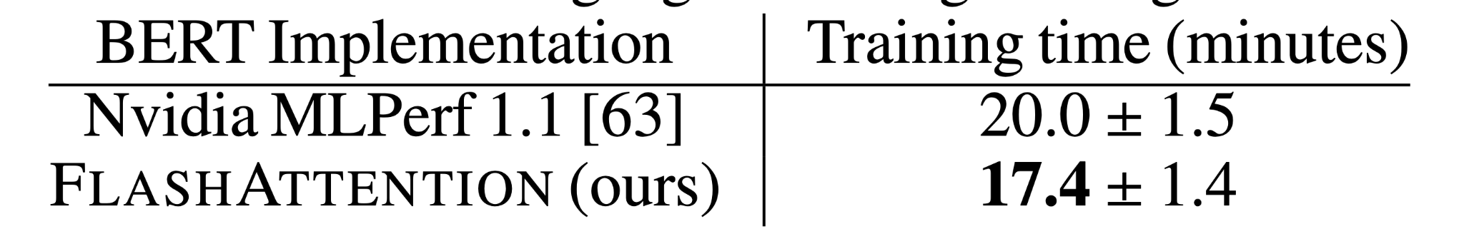
Faster Training - BERT
MLPerf: (highly optimized) standard benchmark for training speed
Training time of BERT-large to reach the target accuracy on 8×A100 GPUs.
Notes:
Here we comes to the first part: Training speed
MLPerf is ..
Compared with Nvidia’s…, their implementation is 15% faster.

Slide 23
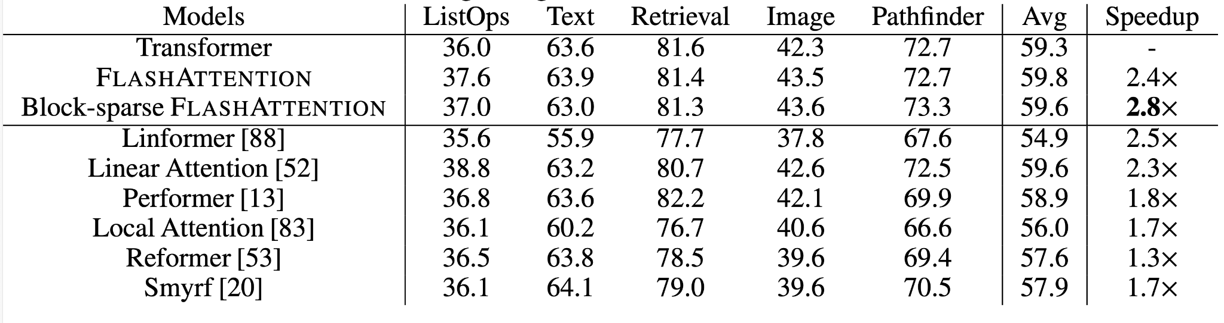
Fast Training - Long-range Arena
Long-Range-Arena benchmarks
Notes:
Besides, they compare the result on LRA benchmark, They measure accuracy, throughput, and training time of all models.
FLASHATTENTION achieves up 2.4× speed-up compared to standard attention.
Block-sparse FLASHATTENTION is the fastest one

Slide 24
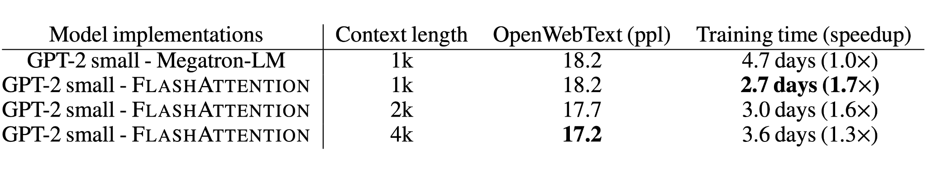
Better Models with Longer Sequences
Training GPT-2 small with larger context length
FLASHATTENTION with context length 4K is faster than Megatron-LM at 1K, and achieves lower perplexity
Notes:
The runtime and memory-efficiency of FLASHATTENTION allow us to increase the context length of models
As to the context length is 4K….
If we look at the context length of 1k

Slide 25
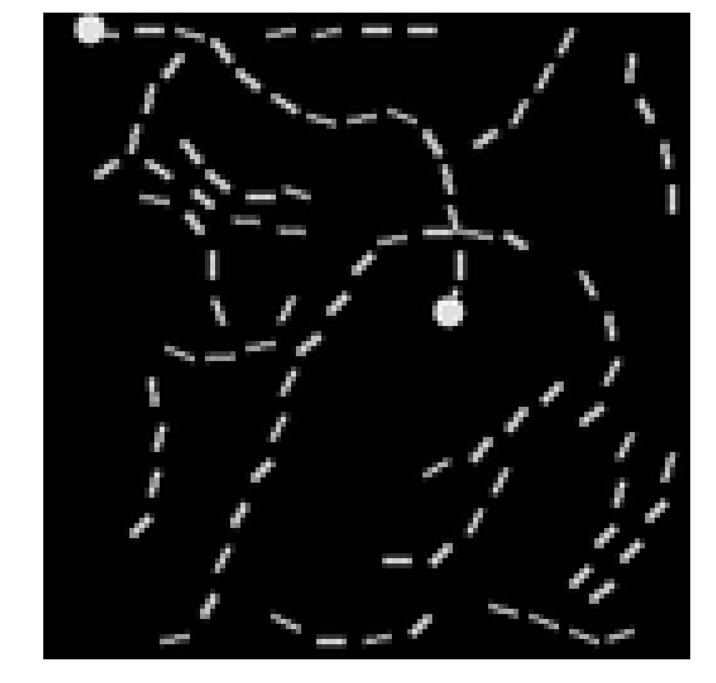
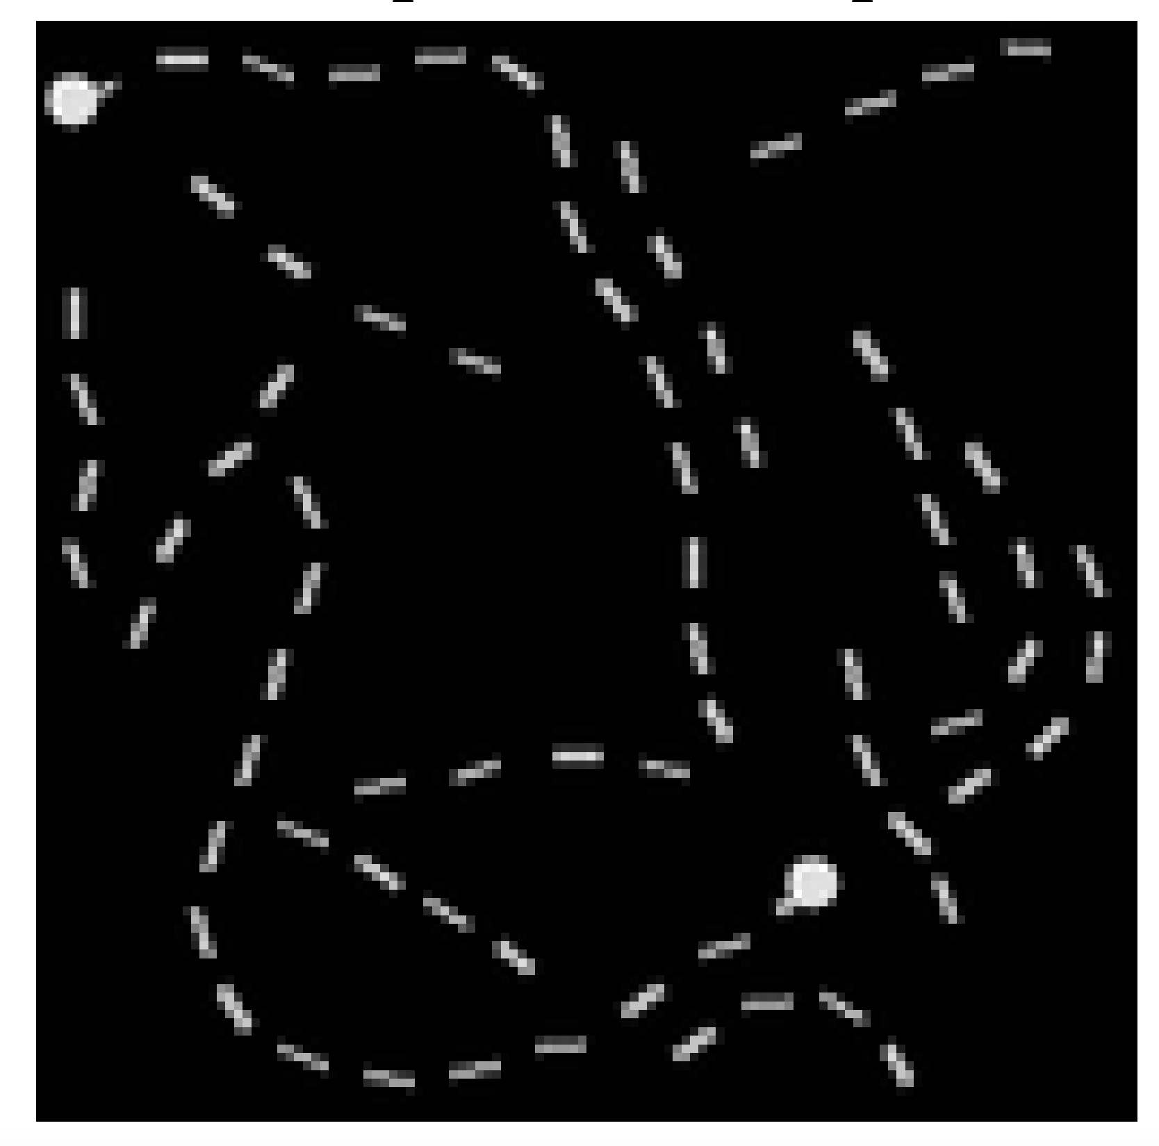
Longer Sequence: Pathfinder tasks
Path-X: tells whether two dots are connected
positive example
negative example
Notes:
Pathfinder tasks are …
If we look at the left hand side

Slide 26
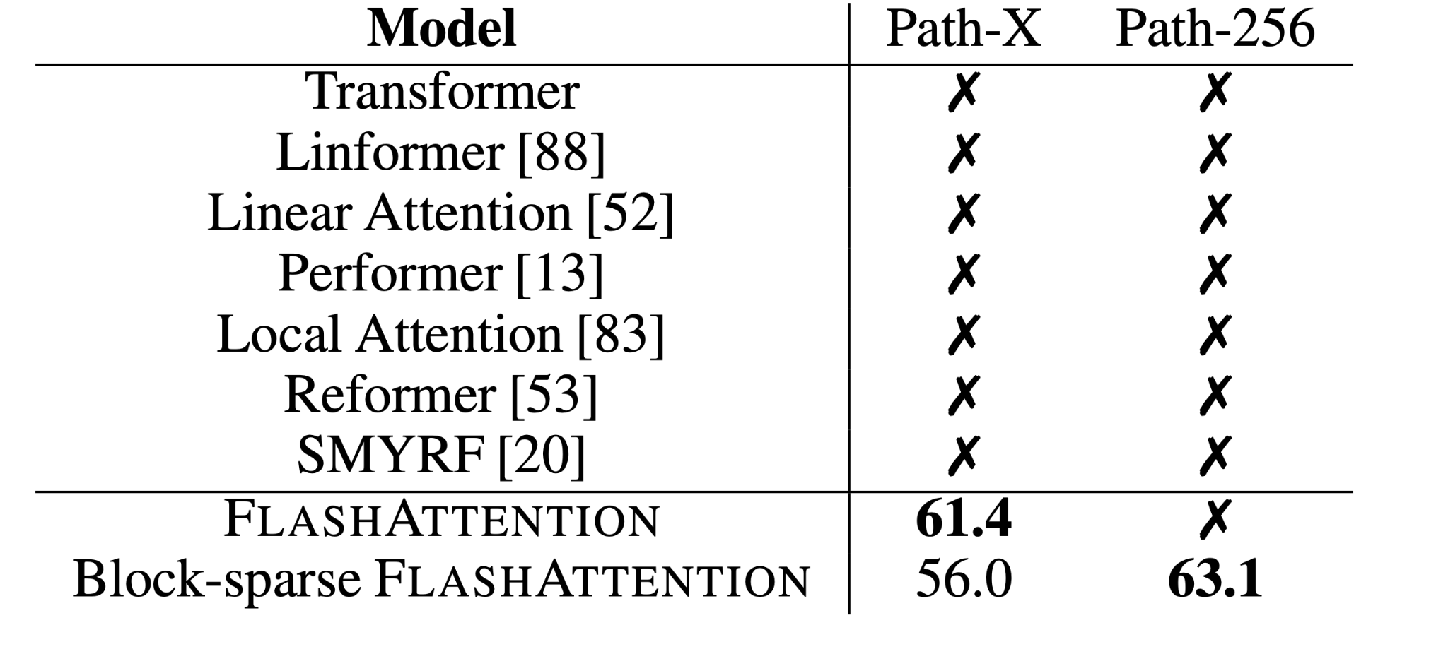
Pathfinder tasks
FLASHATTENTION yields the first Transformer that can solve Path-X
Block-spare FLASHATTENTION enables the Path-256
Notes:
In prior work, all transformer models have either run out of memory, or only achieved random performance.
FLASHATTENTION is the first model being able to solve Path-X and Path-256.
FLASHATTENTION achieves 61.4 accuracy on Path-X.
Additionally, block-sparse FLASHATTENTION could also solve the Path-256.
Path-256 has higher resolution than ..

Slide 27
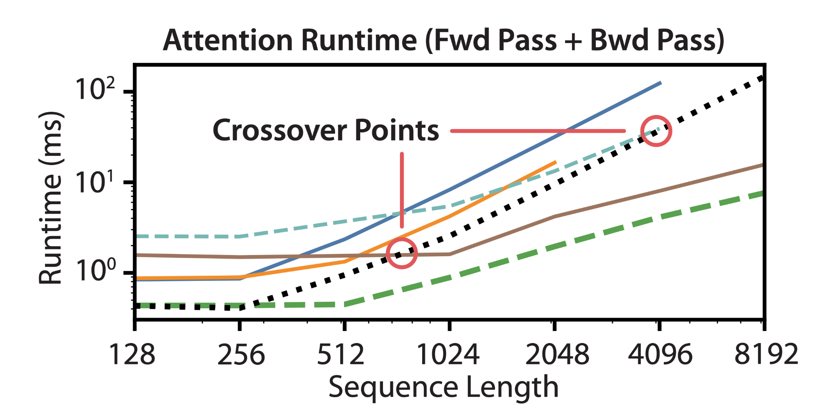
Benchmarking Attention
Notes:
In this figure, they compare the results with exact attention and approximate attention,
FLASHATTENTION runs significantly faster than exact attention baselines, up to 3× faster than the PyTorch implementation.
FLASHATTENTION still runs faster than approximate and sparse attention for short sequences due to fewer memory accesses. Although …..
block-sparse FLASHATTENTION is faster than all implementations of exact, sparse, and approximate attention across all sequence lengths.

Slide 28
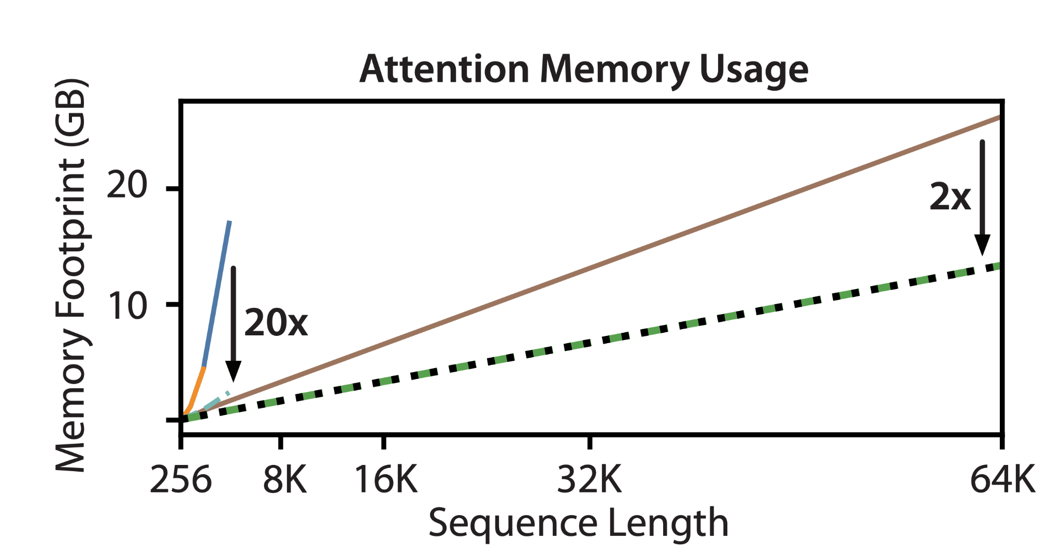
Benchmarking Attention
Notes:
It shows the memory footprint of FLASHATTENTION and block-sparse FLASHATTENTION compared to various exact, approximate, and sparse attention baselines.
FLASHATTENTION and block-sparse FLASHATTENTION have the same memory footprint, which grows linearly with sequence length.
FLASHATTENTION is up to 20× more memory efficient than exact attention baselines, and is more memory-efficient than the approximate attention baselines

Slide 29
Limitations and Future Work
Limitations
Significant engineering effort, need for a method to write algorithms in a high-level language (e.g., PyTorch)
Implementations not transferable across GPU architectures.
Future Works
Technical works: Extensions to support more GPUs
What can we do with longer context? E.g. 8k context length, High resolution images?
Notes:
Limitations of this work is:
Writing a new CUDA kernel requires significant engineering effort, Need for a method to write attention algorithms in a high-level language (e.g., PyTorch), and compiling to IO-aware implementations in CUDA.
Implementations may also not be transferable across GPU architectures.
The future works are:
Their implementation of attention is for a single GPU. However, the attention computation may be across multiple GPUs. Using multiple GPUs adds an additional layer to IO analysis
On the algorithm level, what can we do with longer context? E.g. 8k context length, High resolution images?

Slide 30
Summary
FLASHATTENTION: fast and memory-efficient algorithm for exact attention
Key algorithmic ideas: tiling, recomputation
The upshot: faster model training, better models with longer sequences

Slide 31
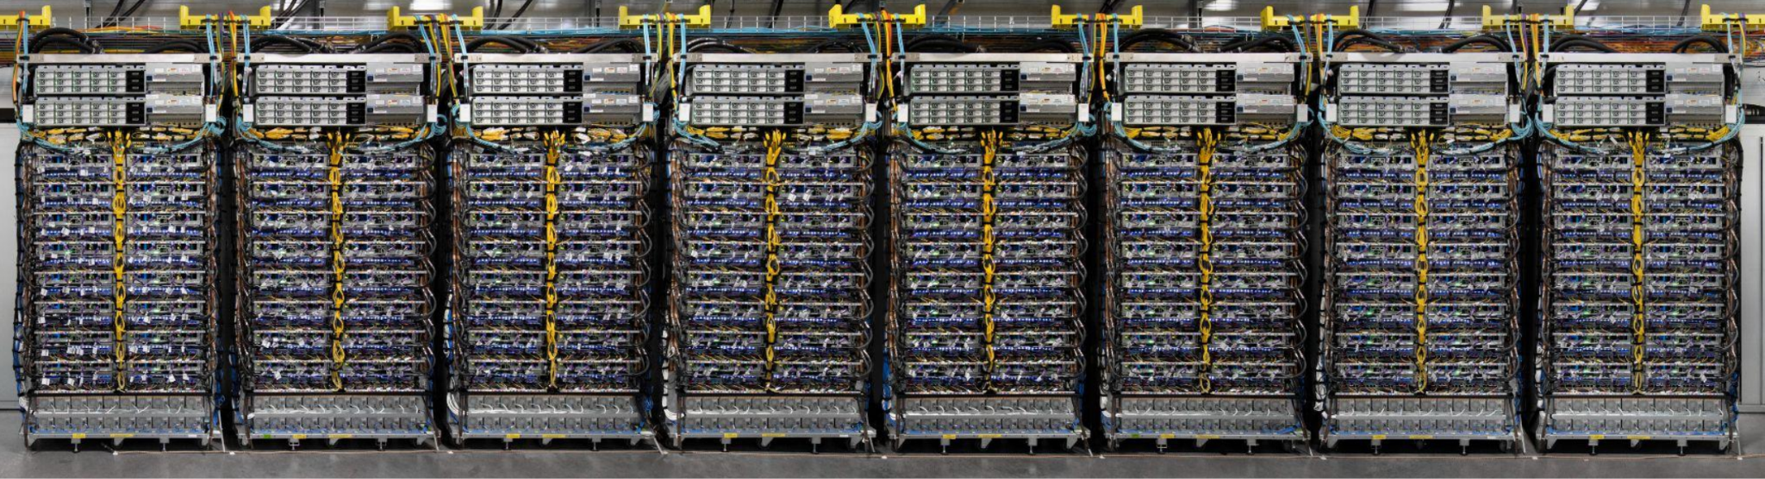
Efficiently Scaling Transformer Inference

Slide 32
Agenda
Motivation
Background
Partition Mechanism
Evaluation
Summary
Notes:
I will introduce the ….

Slide 33
Motivation
Big models require careful attention to parallel layout and memory optimizations
Challenges:
Model parameters do not fit in the memory of a single accelerator chip
Low parallelization of generation makes tight latency targets challenging
Inference cost scales quadratically with input sequence length
Notes:
Large models require careful attention to parallel layout and memory optimizations
They spread across hundreds of GPUs
We have three challenges:
Large models have a large memory footprint, can not fit in
Low parallelization of generation, compared to
Inference cost scales quadratically

Slide 34
Several keys
Build a powerful partitioning framework to enable reaching the limits of model parallel scaling.
Apply memory optimizations
Reduce unnecessary tensor overheads
Maximize the batch size that fits on a given number of chips
Enable higher throughput
Notes:
Build a powerful and abstract partitioning framework to enable reaching the limits of model parallel scaling.
Apply memory optimizations, reduce unnecessary tensor overheads and maximize the batch size that fits on a given number of chips, enabling higher throughput
Reduce unnecessary tensor overheads
Maximize the batch size that fits on a given number of chips
Enable higher throughput

Slide 35
Primary goal
How best to partition a model in order to scale Transformer inference?
How is the performance of different partitioning strategies affected by changes in model size, sequence length, and number of hardware chips?
How does the optimal partitioning strategy change when trading off between latency and throughput?
What is the intuitive and mathematical reasoning behind these effects?
Notes:
Primary goal is to optimize the partition…
In other words, we have three questions

Slide 36
Metrics
Latency: Total time for an inference
Time to process the input tokens present at the start of the inference (“prefill”)
Time to autoregressively generate output tokens (“decode”).
Throughput:
The throughput of prefill or decode is the number of tokens processed or generated per second
model FLOPS utilization (MFU):
The ratio of the observed throughput to the theoretical maximum throughput
Notes:
FLOPS means Floating-point operations per second
We have three metrics to evaluate…

Slide 37
Target
Tradeoff:
model sizes ←→inference cost
Lower latency →smaller batch sizes → worse MFU
If an application requires the lowest possible latency, we need to apply more chips and partition the model in as many ways as we can.
Memory cost:
Tensors of weights and the KV cache in HBM takes a amount of time to be transferred from HBM to chips.
Compute cost:
If all chips were running at peak FLOPS, these matmuls would take a amount of time.
Notes:
The target of this paper is to
Here are two things we need to consider…
First is the memory cost:
Tensors such as weights and the KV cache in on-device high-bandwidth memory (HBM) take the most memory footprint, need to be transferred from HBM to the SRAM. This takes a certain amount of time
Second is the compute cost:
If all chips were running at peak FLOPS, these matmuls would take a certain amount of time.
An N-parameter decoder-only model requires 2N matmul FLOPs in the forward pass per token.

Slide 38
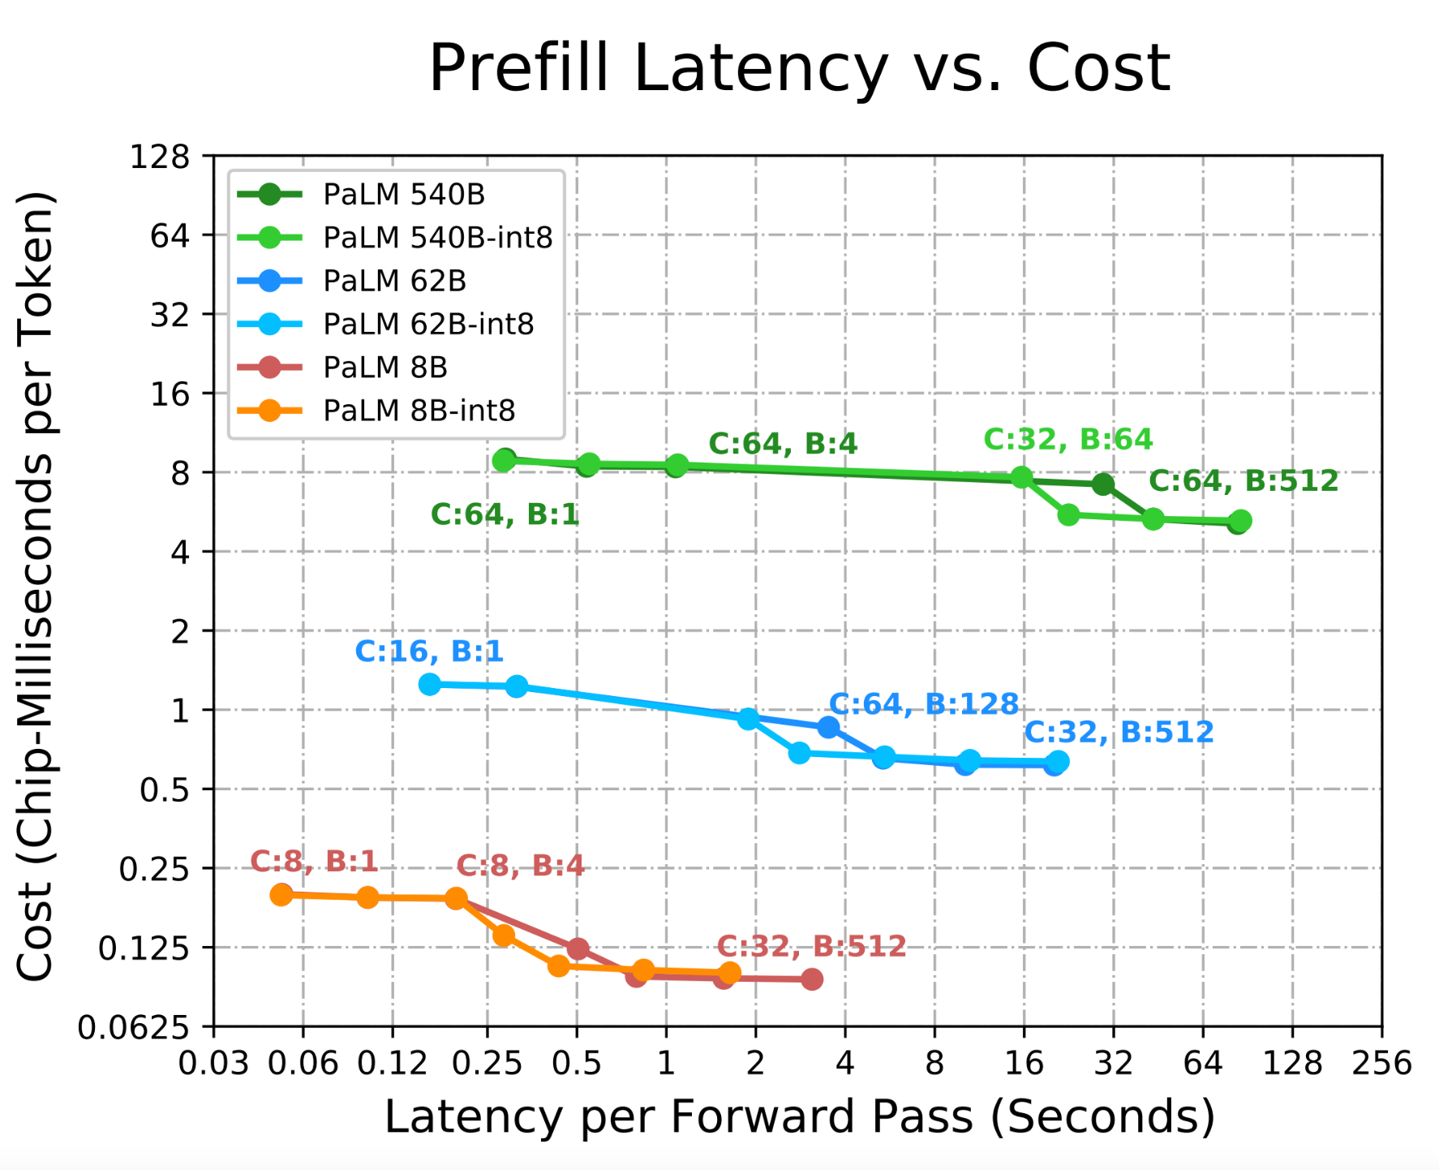
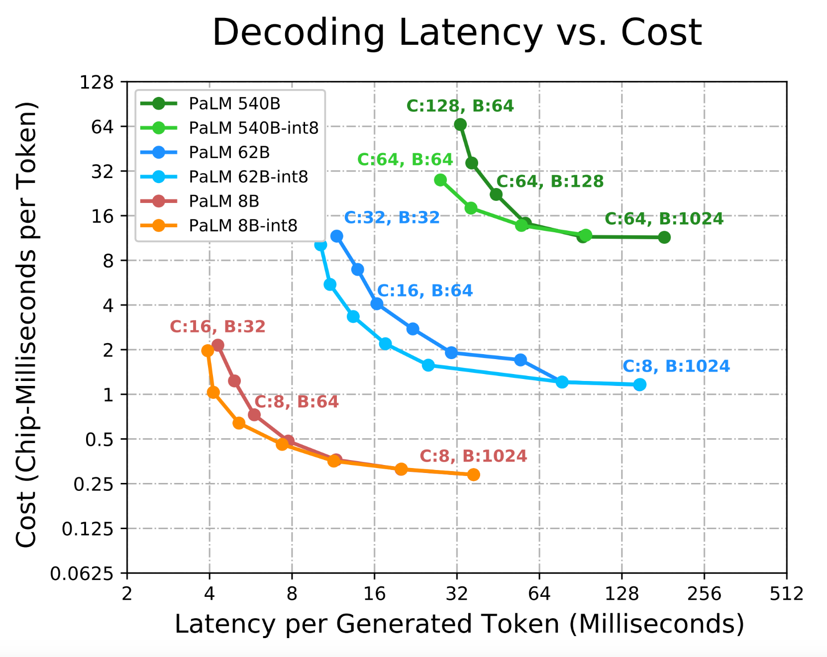
Pareto Tradeoff
C: # of chips
B: batchsize
Notes:
These are the figures for illustration of the tradeoff.
Left figure shows the relationship between model size, latency, and cost in the generate phase, at the Pareto frontier
As we decrease the batch size, we improve the latency but incur higher cost per token.
The right figure shows the relationship between model size, latency, and cost in the prefill phase.
The tradeoff between batch size and latency is less severe in the prefill phase since decoding has lower paralization.

Slide 39
Prefill and Decode Have Different Constraints
Prefill
Compute bound
Can be run in parallel
Uses feedforward network
Decode
Memory bound (by KV-Cache)
Autoregressive generation is sequential
Uses feedforward network and attention
Notes:
Goal: understand partitioning tradeoffs for transformers
Prefill and decode have fundamentally different constraints
We’ll first discuss ff and attn, and then circle back to evaluating which ff to use for which phase

Slide 40
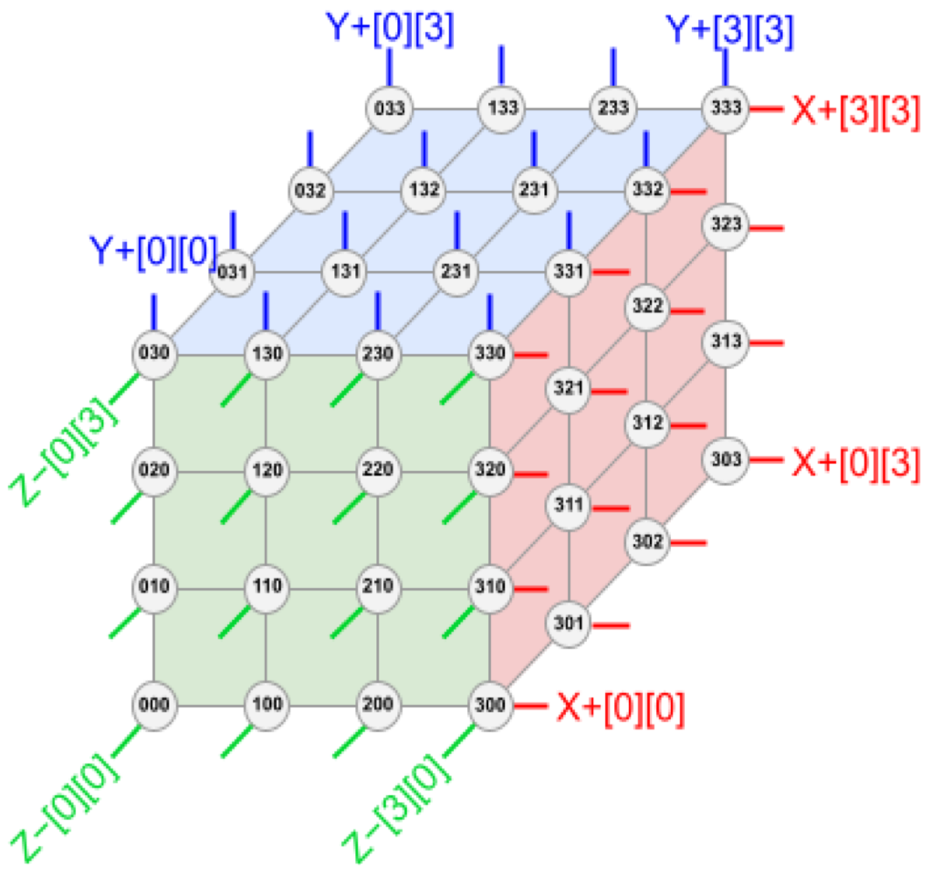
Understanding the TPU
v4 TPUs are 4x4x4 physical arrays of compute units optimized for matrix operations
Data can be sharded along any (or all) of the TPU axes
Notation: In the tensor A_{x}BC_{yz}, A is sharded along the x axis, and C is sharded along both the y and z axes
Notes:
Physical “tensor”
Explain notation

Slide 41
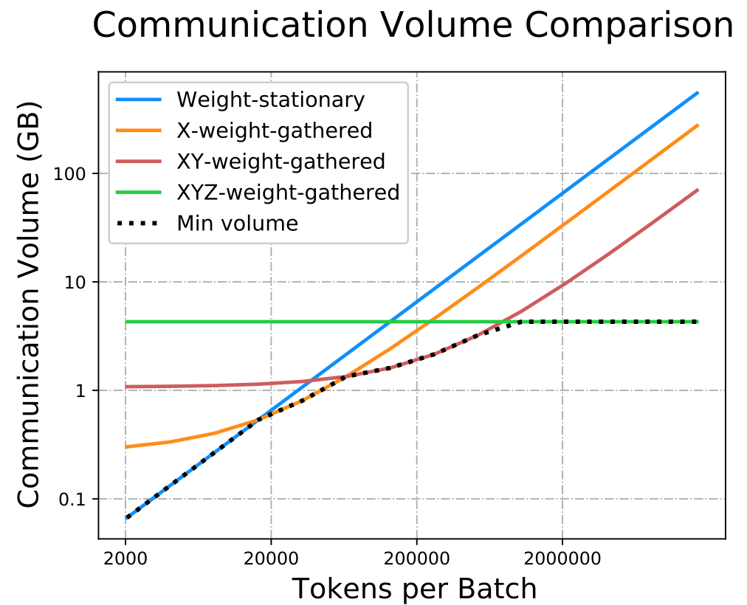
Communication is a Bottleneck for Feedforward Networks
Batch size and chip count increase feedforward communication overhead
We can analytically find the best partitioning strategy depending on these conditions
Notes:
As batch size increases, so does communication complexity
Different partitioning strats for different batches.
We can analytically evaluate this tradeoff

Slide 42
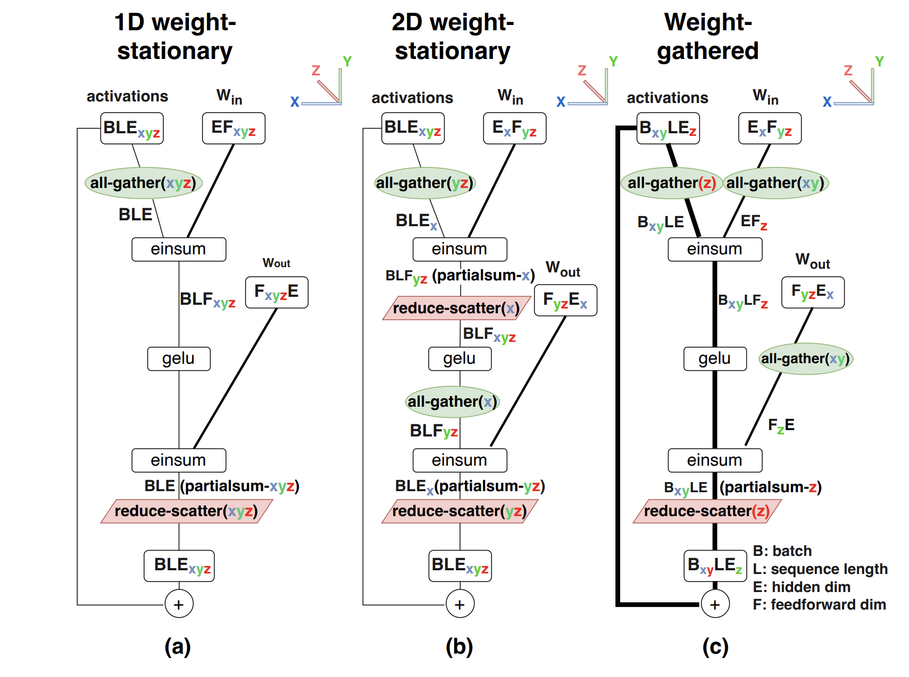
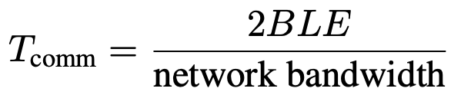
1D Weight-Stationary is Optimal for Small Chip Counts
Fully shard E by F weight matrix over each chip along F-axis only
Communication is roughly constant
Notes:
Compute graph for FF layer is essentially just 2 matmuls (einsums)
Does the dumbest thing you can think of
TRICK: By partitioning along the output (ff) dimension, the first matmul gives the exact right activation shard to compute second

Slide 43
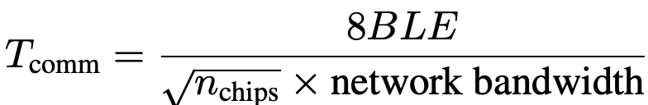
2D Weight Stationary Scales Better With Chip Count
Shard Weights evenly along E and F dimensions (𝛰(√n_{chips}) chips each)
Alternating einsum dimensions ensures correct computations without individual chips needing full activation tensors
Requires more aggregation but communication scales better
Notes:
Can partition roughly evenly along E and F
Lose previous trick
New trick: By alternating matmul aggregation dimension we don’t ever have to fully replicate an activation shard

Slide 44
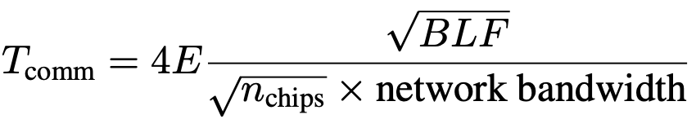
Weight Gathering is best for large batches
Shard activations instead of weights on chips by batch
Adds all-gathers but for small tensors, but saves on overall communication for very large batches
Weights can be fully gathered or hybrid
Notes:
Adds more all-gathers, but on small tensors

Slide 45
Takeaway: Weight Gathering is Important for Large Batches

Slide 46
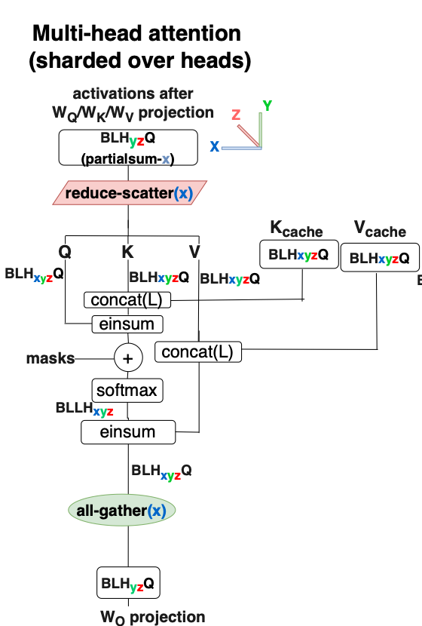
Typical Attention Layers are Memory Bound
Attention can easily be parallelized over attention heads
We can’t take full advantage since attention is typically memory bound
Notes:
Briefly explain typically multi-head attn

Slide 47
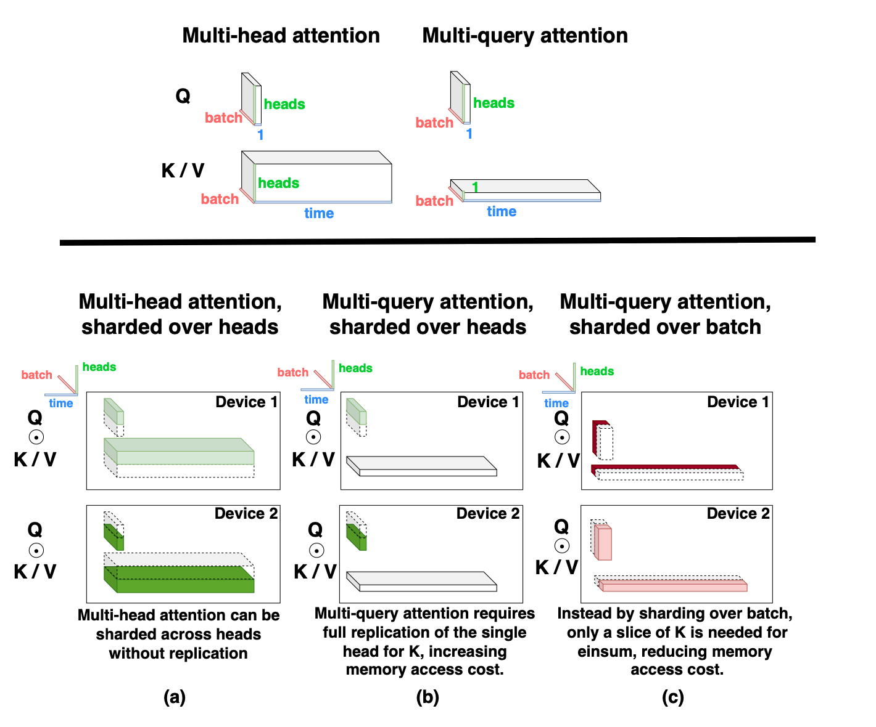
Using Multi-Query Attention Saves Memory
Multi-head attention memory scales with number of input heads
Multi-query attention shares one key and value head for each input head
Notes:
MQ attn lets us use one key/value

Slide 48
Sharding Multi-Query by Batch Improves Scaling
Notes:
MQ att

Slide 49
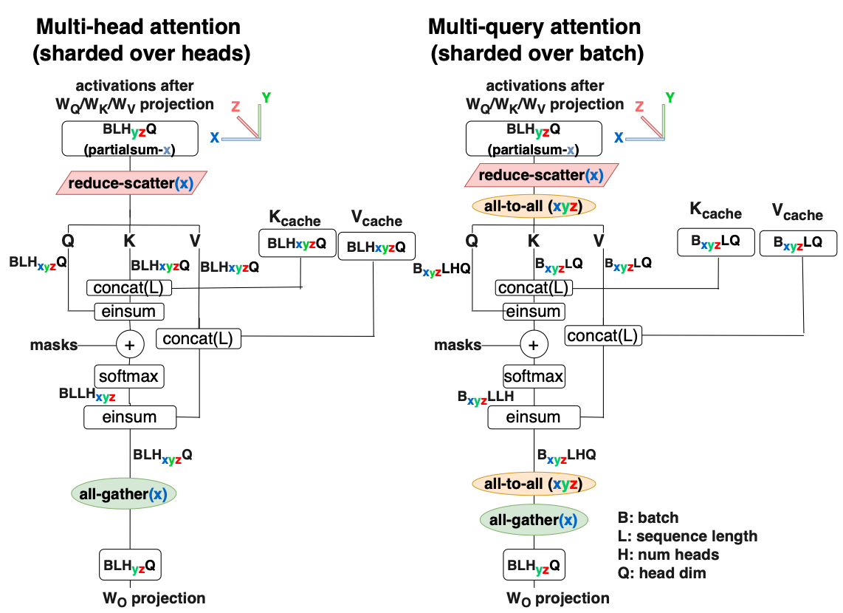
Attention Partitioning Comparison
KV Cache sharded by attention heads
KV Cache sharded by batch
Extra communication is worth the memory savings

Slide 50
Lower Level Optimizations
Looped CollectiveEinsum
Run some communication and computation concurrently
Parallel attention and feedforward layers
Results in lower latency for small batches and higher MFU for large batches
Weight quantization
Reduces memory load time for small batches

Slide 51
Case Study: Optimizing PaLM with this Framework
PaLM is a family of transformer models that natively supports multi-query attention.
Experimental Setup:
Up to 256 TPU v4 chips
Each chip can run bfloat16 matrix arithmetic at 275 TFLOPS
Has 32 GiB of High Bandwidth Memory, 1200 GB/s bandwidth
270 GB/s interconnect bandwidth in a 3d torus topology
Notes:
Methodology We now conduct an empirical study of our techniques on the PaLM family of models (Chowdhery et al., 2022), which we select since the model architecture incorporates the techniques of multiquery attention and parallel attention and feedforward layers.
Our inference framework is based on JAX (Bradbury et al., 2018) and XLA (XLA, 2019), and our original high-level im- plementation was based on T5X (Roberts et al., 2022). We use up to 256 TPU v4 chips (Google, 2022) for our bench- marks. Each TPU v4 chip can run bfloat16 matrix arithmetic at 275 TFLOPS, has 32 GiB of High Bandwidth Memory (HBM) at 1200 GB/s of bandwidth, and has 270 GB/s of interconnect bandwidth in a 3D torus topology (TPUv4).
For the PaLM 540B model we padded the number of at- tention heads up from 48 to 64 in order to partition more effectively on 64+ chips. This adds 18B parameters to the model, which comes at a 3% MFU cost, which was more than recovered by being able to partition more effectively.

Slide 52
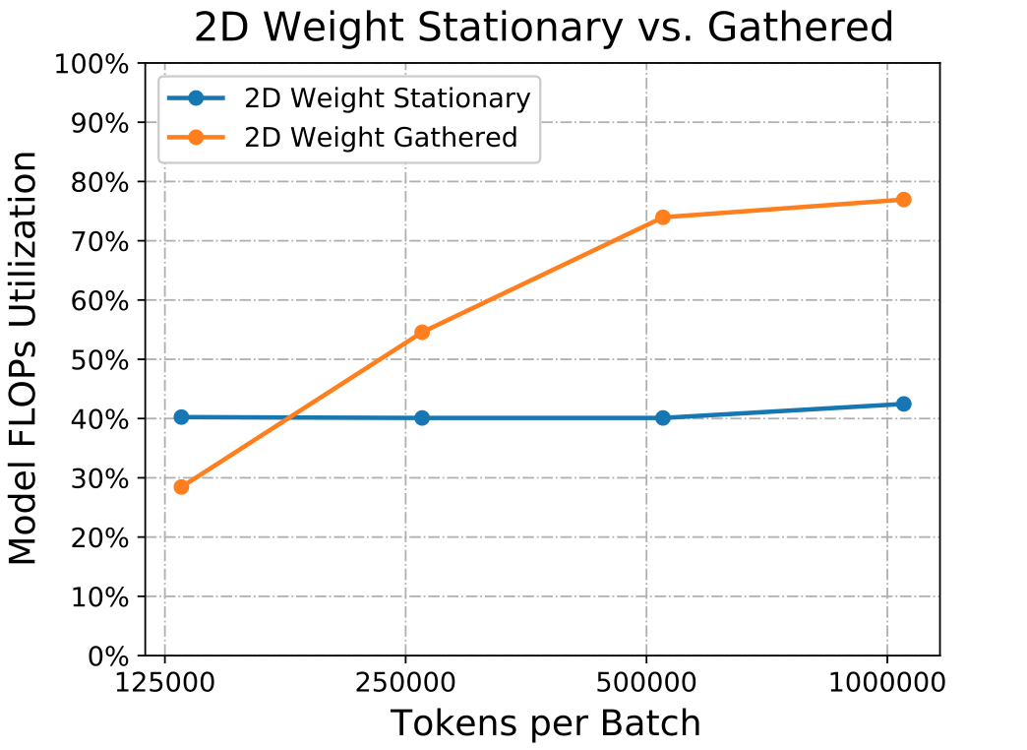
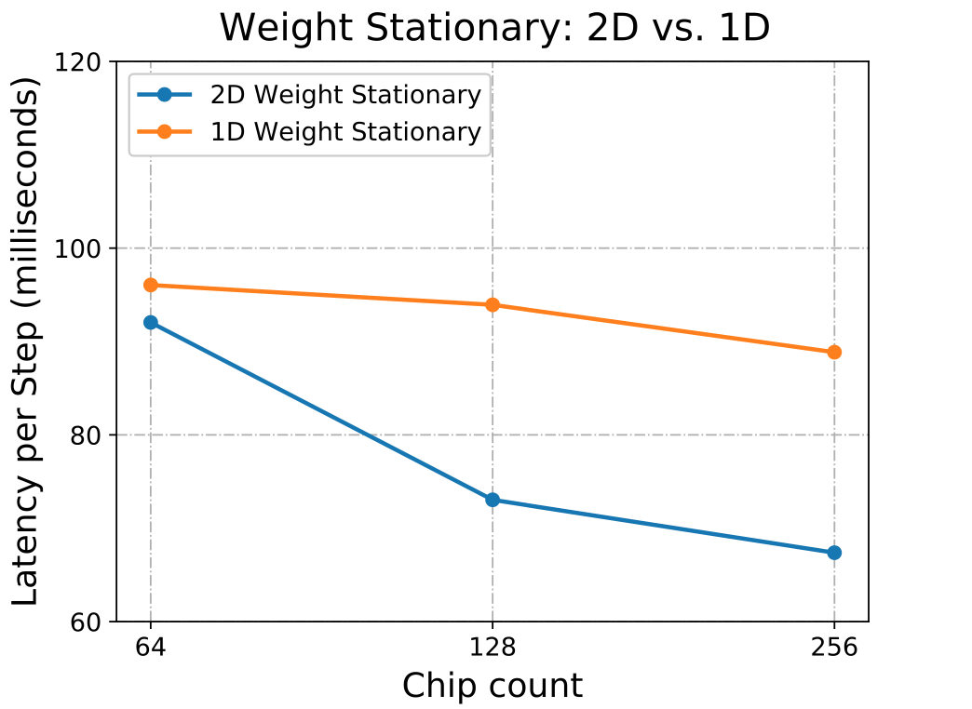
Feedforward Partitioning for Prefill & Decode in PaLM
Notes:
Prefill: (LEFT)
Prefill is throughput sensitive
Weight Gathered partitioning enables better resource utilization for large batches
Decode: (RIGHT)
Low batch size relative to prefill
Both 1D and 2D become communication limited
2D scales better because activations aren’t shared
Basic strat:
In prefill select stationary for small batches & gathered for large. In decode batch size usually small, so take stationary

Slide 53
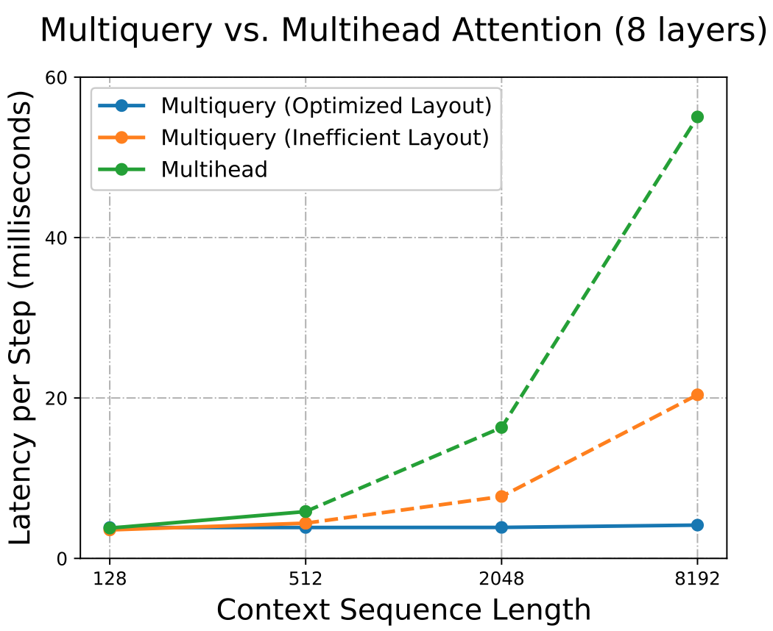
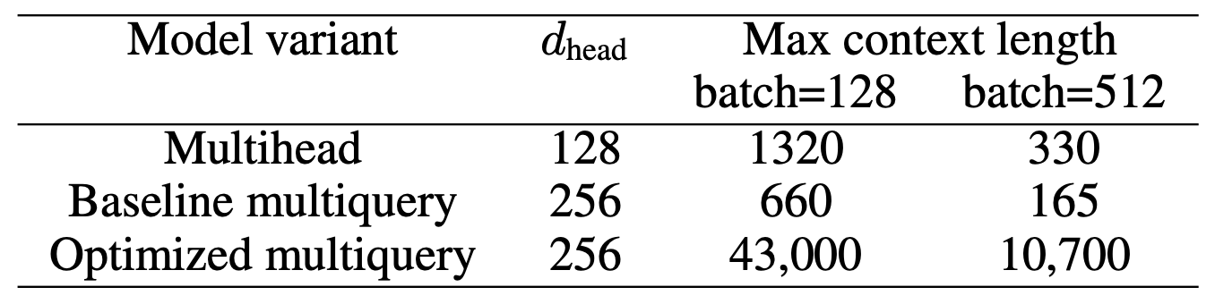
Multi-Head vs Multi-Query Attention in PaLM
Notes:
Dotted line = KV cache no longer fits in memory

Slide 54
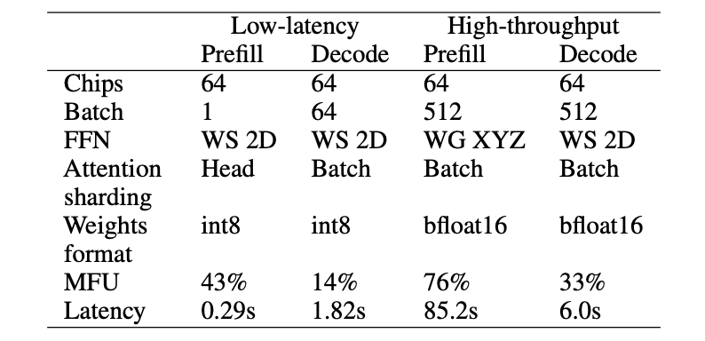
Pareto-Optimized PaLM for a Variety of Applications
Abstract framework can be used to optimize for both throughput and latency sensitive applications
Example configurations for PaLM 504B: Prefill processes 2048 tokens, decode generates 64 tokens

Slide 55
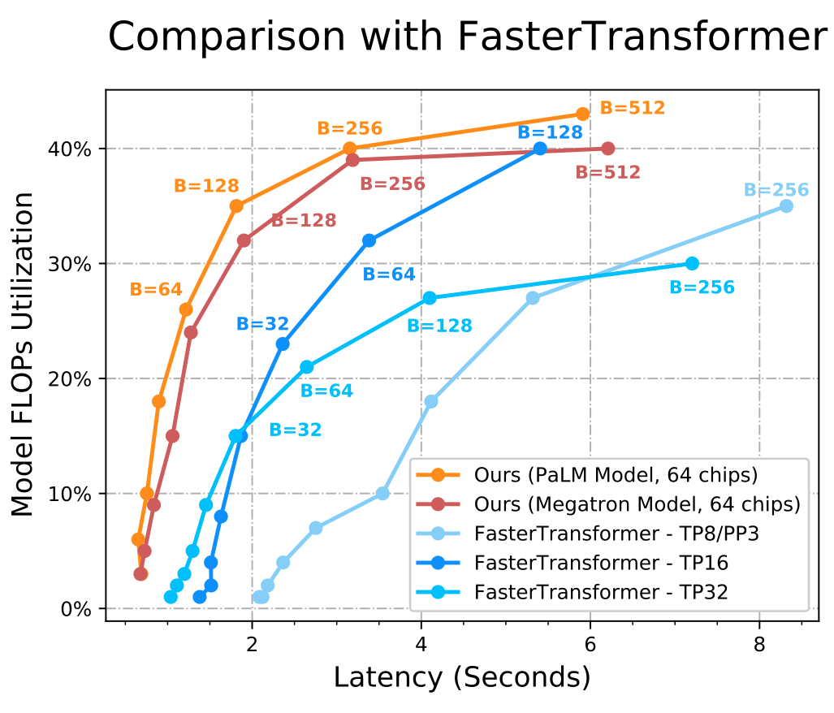
These Techniques Beat FasterTransformer Benchmarks
FasterTransformer (FT) is a set of highly optimized transformer models
Both PaLM and Megatron have a better latency/utilization tradeoff than FT when optimized as proposed

Slide 56
Summary
This paper presents a set of transparent design principles for partitioning transformer models
Analytic solutions are used to justify partitioning recommendations in a variety of conditions
The design framework is applied to PaLM which performs competitively against a robust benchmark suite

Slide 57
Limitations and Future Work
Limitations
This framework only applies to TPU optimizations (somewhat nonstandard)
No automated system is implemented to apply this framework
Future Work
Directly address either of the limitations
Expand framework to include other quality of service metrics (eg: low power)

Slide 58
Acknowledgment
FlashAttention: Fast and Memory-Efficient Exact Attention with IO-Awareness
Online normalizer calculation for softmax
FlashAttention-2: Faster Attention with Better Parallelism and Work Partitioning
Efficiently Scaling Transformer Inference
FlashAttention - Tri Dao | Stanford MLSys #67
TPU v4: An Optically Reconfigurable Supercomputer for Machine Learning with Hardware Support for Embeddings

Slide 59
Q&A
Thanks for your attention!

